Slide 1
Introduction to Python
Overview
In this lesson, students will be introduced to executing Python code in a Jupyter Notebook environment. They’ll learn variables and data types, along with string formatting and concatenation.
Duration 120 minutes
Learning Objectives
In this lesson, students will:
Explain the value of Python.
Use Jupyter Notebook to execute basic Python programs.
Use operators to define and manipulate variables.
Differentiate between data types in Python.

Slide 2
Pre-Class Materials and Preparation
For remote classrooms: Virtual breakout rooms and Slack may be needed to facilitate the partner exercise and discussions. As you plan for your lesson:
Consider how you’ll create pairs for the partner exercise (randomly, or with pre-assigned partners).
Determine how (if at all) exercise timing may need to be adjusted.
For helpful tips, keep an eye out for the For remote classrooms tag in the speaker notes.
Prepare screenshots and answers to exercises in advance so that they can be easily shared in Slack during your lecture.

Slide 3
Pre-Class Materials and Preparation (Cont.)
Pre-Work Review: Many of the concepts covered in this class will recap what students learned in the pre-work; in particular, these myGA lessons:
Introduction to Python
Manipulating Variables in Python
Data Types in Python
We recommend reviewing the pre-work lessons to understand what students will come to class knowing. Click here to see the study guides for these lessons. You can also view the pre-work materials on myGA.
For review or extension topics, review the notes in the pre-work for recommendations on how to teach the concept. Leverage the discussions, exercises, and knowledge checks to gauge students’ understanding of concepts. You can adjust your approach to the lesson overall based on how students do with these exercises.

Slide 4
Suggested Agenda
Time | Activity
0:00–0:30 | Welcome + Introduction to Python
0:30–0:45 | Variables and Data Types
0:45–0:55 | Break
0:55–1:25 | Manipulating Variables
1:20–1:50 | Changing Data Types
1:50–2:00 | Wrapping Up, Q&A, and Exit Ticket Completion

Slide 5
Jupyter Notebook
The exercises referenced in this lesson can be found in the Python Workbooks + Data folder.
Our first few lessons begin by reviewing the notebook, as the same material was covered in the pre-work.
If students feel that they are able to confidently solve the challenges in the workbook, you can quickly skim through the lesson content and have them only complete the challenges.

Slide 6
Introduction to Python
Notes:
Duration: 30 minutes

Slide 7
Before We Begin…
Prior to class, everyone should have Anaconda installed on their laptops in order to use Jupyter Notebook.
If you don’t, visit https://www.anaconda.com/products/individual and download the installer for your operating system. Jupyter Notebook will be bundled in with this installation.
Notes:
Purpose: Ensure that students have the correct programs installed for the course. They will need this set up in order to use the Jupyter Notebook.

Slide 8
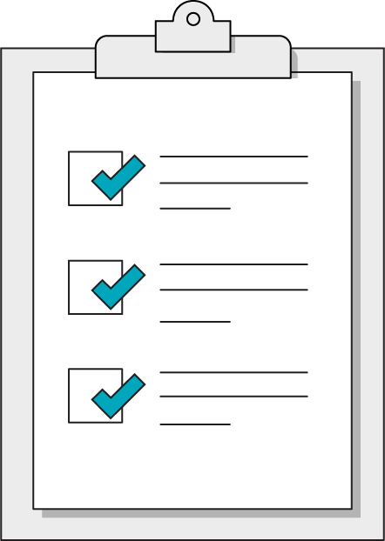
Our Learning Goals
Explain the value of Python.
Use Jupyter Notebook to execute basic Python programs.
Use operators to define and manipulate variables.
Differentiate between data types in Python.
Notes:
Purpose: Set expectations for the lesson.
TEACHING TIPS:
Today's topics may seem a bit basic, but remind students that these are the foundational building blocks of complex programs. No matter how far they get as programmers, data types will ALWAYS matter and can often be the source of bugs!
For remote classrooms:
Capture a screenshot of this slide and drop it in the class Slack channel.

Slide 9
What We’ll Practice Today
This class is a blended learning experience. It connects to and reinforces topics that you encountered in the myGA pre-work.
We’re going to return to topics covered in the pre-work and build upon them:
Creating and manipulating variables.
Python data types.
Notes:
Purpose: Connect the rest of class to what we’ve already learned in the pre-work.
TALKING POINTS:
We know that you encountered some of what’s in today’s lesson in the pre-work. That’s intentional! We use a blended learning approach that incorporates myGA, assessments, and in-class lessons. They all work together to help you succeed in the course and let us know where you’re coming from.
We don’t want to bore you with stuff you already know, but we also don’t want to skip over really crucial topics. We’ll use discussions and exercises to make sure we’re going at your speed when it comes to familiar topics, as well as the new ones.
The pre-work helps you come into the classroom with a solid, foundational understanding of the basics. We’re going to practice and reinforce those topics and then start to build upon them.

Slide 10
1.1 Our First Jupyter Cell
10 minutes
Throughout our Python journey, we’ll be using an interactive Python environment called Jupyter Notebook to accompany our lessons with coding exercises.
Let's open the notebook associated with this lesson and execute the first cell to learn more about Python's founding principles, known as the Zen of Python.
Notes:
Purpose: Introduce students to the tool we’ll use for the unit.
TALKING POINTS:
In the notebook, you should see the first cell filled in with the “import this” command.
Executing this Python easter egg will reveal the Zen of Python!
TEACHING TIPS:
Choose whichever lines you feel are significant to emphasize, although we suggest "Simple is better than complex." and "Readability counts." as quotes that embody the approachable nature of Python.

Slide 11
Jupyter Notebook Review
10 minutes
Let’s dive right in and use what we learned in the pre-work! We want to understand where you are in your learning journey so that we can give the best possible experience in class.
Look over the exercises in today's Jupyter Notebook and attempt any that seem immediately doable to you.
Then, rate your confidence level on today's subjects from 1–5.
Notes:
Purpose: Understand how much students have retained from the pre-work lessons.
TEACHING TIPS:
This exercise will help you gauge where students are in terms of how much they retained from the pre-work so that you can appropriately adjust the rest of the lesson/future lessons.
Remind students that we're not asking them to complete all questions immediately. Note that, if they are struggling, we’ll recap how to write each of them in this and the following lesson.
For remote classrooms:
Ask students to rate their confidence in this subject using Slack response emojis 1–5, or a quick anonymous poll. If ALL students feel confident in this subject, feel free to skip through the actual lesson slides and dive right into the exercises in the notebook.

Slide 12
Why Python?
There are plenty of great programming languages out there.
Why are we learning Python?
Notes:
Purpose: Have students articulate Python’s value as a language.
TEACHING TIPS:
This should be a review of what students learned in the pre-work.
Solicit reponses for a few minutes, then advance to the next slide for our answers.

Slide 13
Why Python?
Python has grown as a high-level, general-purpose programming language with a huge open-source community supporting it.
It’s the fastest-growing programming language on the market, especially within the data analysis community.
Python's primary advantages:
Clean syntax.
A wealth of specialized, pre-built libraries, such as Pandas for data analysis and Django for web development.
Notes:
Purpose: Review the benefits of Python.
TALKING POINTS:
Libraries are especially powerful because they allow us to solve common problems and use cases with pre-tested, optimized solutions.
Python programmers rarely have to "reinvent the wheel" and write base-level code, thus allowing us to focus on the applications instead.
TEACHING TIPS:
This should be a review of what students learned in the pre-work.

Slide 14
Variables and Data Types
Introduction to Python
Notes:
Duration: 15 minutes

Slide 15
Variables
Variables are names that have been assigned to specific values or data.
Python allows us to easily define and redefine variables using a simple assignment operator (equals sign).
best_programming_language = "python"
Variable name
Value stored by the variable
Notes:
Purpose: Review variables.
TALKING POINTS:
Variables constitute the building blocks of any program and are fundamental to making logical sense of how individual lines of code combine into complex programs.
If we need the computer to "remember" ANYTHING, it should be a variable!
These names can be almost anything you want, but there are some restrictions and best practices.
TEACHING TIPS:
This should be a review of what students saw in the pre-work.

Slide 16

Restrictions on Variables
Variable names cannot be just a number (i.e., 2, 0.01, 10000).
Variables cannot be assigned the same name as a default or imported function (i.e., “type,” “print,” “for”).
Variable names cannot contain spaces.
Notes:
Purpose: Introduce restrictions on variables.

Slide 17
Best Practices for Variables
Variable names in Python should be lowercase.
A variable’s name should be indicative of the concept it represents in your program. Coming up with sensible variable names can take some time and thought, but this will save you a lot of confusion later on.
If you have to include multiple words in your variable name, use an underscore to separate them. This is known as snake case.
Notes:
Purpose: Introduce best practices for variables.

Slide 18
Primitive Data Types in Python
 | Explanation | Examples
String | A collection of characters representing a text-based value, such as a message. | my_planet = "earth" secret_password = "password"
Integer | Any whole number without decimal points. | heist_members = 11 bakers_dozen = 13
Float | Numbers including points after the decimal, or "floating point" numbers. | gigawatts = 1.21 low_low_price = 49.99
Boolean | The concept of true or false values. | python_is_readable = true programming_is_simple = false
Notes:
Purpose: Review Python data types.
TALKING POINTS:
There are more data types to come, but these provide the fundamental building blocks for all information stored in Python programs.
When thinking about which data type to choose, consider the functionality for which you'll need the variable. Will you be doing math with it? Or using it to display messages? Or maybe you'll need it to perform logical operations?
TEACHING TIPS:
This should be a review of what students saw in the pre-work.

Slide 19
Knowledge Check!
Match the values on left with their correct data type on the right.
"Hello world"
6
7.2
True
Float
Boolean
String
Integer
Notes:
Purpose: Review data types.
TEACHING TIPS:
This should be a recap from the pre-work. Have students shout out the answer and then move onto the demo.

Slide 20
1.2 Introduce Yourself
10 minutes
In Cell 1.2, we've already set up a message printed to the console. However, if we were to execute it right now, you’d see an error. To get this message to work, we have to define the following variables with string type values:
greeting
name
mood
Don’t worry about fully understanding what we’ve done to have the message show up — we'll be covering that throughout this lesson!
Notes:
Purpose: Give students time to practice creating variables.
TEACHING TIPS:
This should be a review of what students saw in the pre-work.

Slide 21
Manipulating Variables
Introduction to Python
Notes:
Duration: 25 minutes

Slide 22
Operators
We’ve already seen the assignment operator in action, but there are other operators that can modify variable values:
Symbol | Name | Explanation
+ | Addition | Adds numbers or strings.
- | Subtraction | Subtracts numbers.
* | Multiplication | Multiplies numbers or strings.
/ | Division | Divides numbers.
% | Modulus | Produces the remainder from division.
** | Exponent | Raises the first number to the second number’s power.
Notes:
Purpose: Review types of operators.
TEACHING TIPS:
This should be a review of what students saw in the pre-work.

Slide 23
Concatenating Strings
You may have noticed that some of the operators, especially the addition operator, work on strings as well as numbers.
Adding two or more strings together is called concatenation.
beverage_type = "sparkling water"
flavor = "grapefruit"
favorite_drink = flavor + beverage_type
Notes:
Purpose: Review concatenation.
TEACHING TIPS:
This should be a review of what students saw in the pre-work.

Slide 24
A Problem With Concatenation
beverage_type = "sparkling water"
flavor = "grapefruit"
How could we concatenate these two variables into a single variable named “favorite_drink”?
There’s a good chance that our first solution will end up being "grapefruitsparkling water.” How can we fix that awkward combination of words?
Notes:
Purpose: Discuss approaches for concatenation.
TEACHING TIPS:
There are a lot of potential answers here, as some might suggest adding a space to either of the variables.
The best solution, however, would be to add a space in the middle as a separate string, not stored in any variable.
This solution might not be intuitively obvious at first but should introduce the concept that not every value needs to be stored in a variable.

Slide 25
Concatenation vs. String Interpolation
You can imagine that concatenating multiple strings might result in some complex, hard-to-read statements. However, Python provides a way to directly inject, or interpolate, a variable directly into a string using f-strings.
greeting = "Hello there"
person = "Professor Park"
message = f"{greeting}, {person}."
The message variable equates to “Hello there, Professor Park.”
Notes:
Purpose: Review string interpolation.

Slide 26
Updating Variables
Variables wouldn’t be very useful if their values couldn’t vary or change. You can use the assignment operator to re-assign values to an existing variable.
favorite_language = "SQL"
favorite_language = "python"
You can even use the previous value when re-assigning!
my_current_age = my_current_age + 1
# Happy Birthday!
Notes:
Purpose: Review the concept of re-assigning variables.
TEACHING TIPS:
This should be a review of what students saw in the pre-work.

Slide 27
A Quick Comment on Comments
You’ve also seen that our Jupyter Notebook contains some lines of text that start with a hashtag (#). These are known as comments.
Comments are used to provide explanations and guidance throughout a program; Python will not try to execute these as code.
# This is a comment and will not cause errors!
Notes:
Purpose: Review code commenting.
TALKING POINTS:
Well-commented code makes life easier for anyone reading your programs in the future, including yourself!
There will be times when you have to return to your old code and you’ll have no idea how it works or why you wrote it the way you did unless you added comments at the time.
TEACHING TIPS:
This should be a review of what students saw in the pre-work.

Slide 28
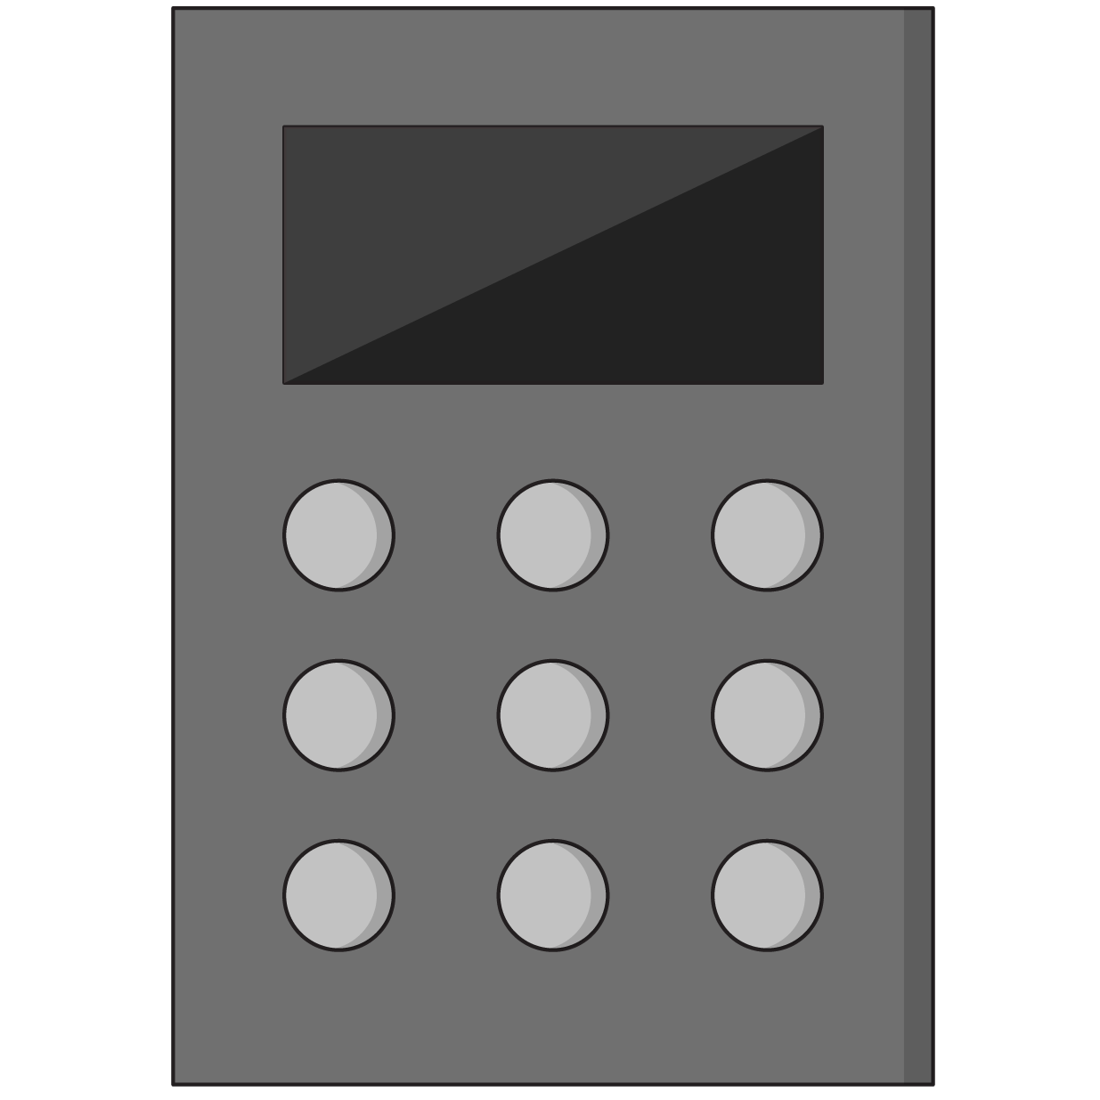
1.3 Operators and Updating Variables
10 minutes
Let’s practice with a birthday calculator trick in the Jupyter Notebook by following the instructions in the comments.
Notes:
Purpose: Give students time to practice changing variables.
TEACHING TIPS:
This should be a review of what students saw in the pre-work.

Slide 29
All the Values That Are Fit to print()
We’ve seen a few examples using the print() function so far.
We’ll learn more about functions later on, but print() is an important first function to know. It allows us to output messages to the console, which can be extremely valuable for debugging a program.
If something isn’t working, we can always use some print() statements to investigate whether or not our variables contain the values we expect.
Notes:
Purpose: Frame how print() can be helpful in working with code.

Slide 30


1.4 Python Mad Libs
10 minutes
In this exercise, we’ll practice combining strings together and including variables in string messages.
Notes:
Purpose: Give students time to practice working with concatenation and string interpolation.

Slide 31
Changing Data Types
Introduction to Python
Notes:
Duration: 30 minutes

Slide 32
You’re Just Not My type()
One significant cause of errors in Python occurs when you’re trying to perform an operation on variables of different types:
2 + "apple"
# This will give you an unsupported operand error!
If you’re unsure what data type a variable contains, you can use the type() function to investigate, especially in combination with print().
print( type(mystery_variable) )
Notes:
Purpose: Frame up type casting.
TEACHING TIPS:
This should be a review of what students saw in the pre-work.

Slide 33
...But I Can Change!
We can overcome incompatible data types by type casting, or changing the data type of a variable:
str(2) + "apple"
# This turns 2 into a string
This technique has its limits, however. If we tried converting “apple” to an integer, we’d get another error, as that just doesn’t make sense.
Notes:
Purpose: Review type casting.
TEACHING TIPS:
This should be a review of what students saw in the pre-work.

Slide 34

Compatible Types
Of the four data types we’ve learned so far, which do you think can be converted into each other and which cannot?
Strings
Integers
Floats
Booleans
Notes:
Purpose: Get students to think through limits on type casting.
TEACHING TIPS:
We’ll get into “truthiness” when we discuss conditionals, but this is a good time to introduce the concept of Boolean conversion if students guess this incorrectly.
You can think of “0” and “1” in Boolean terms and connect it to binary logic.
The only incompatible conversions are turning strings and Booleans into integers or floats.

Slide 35
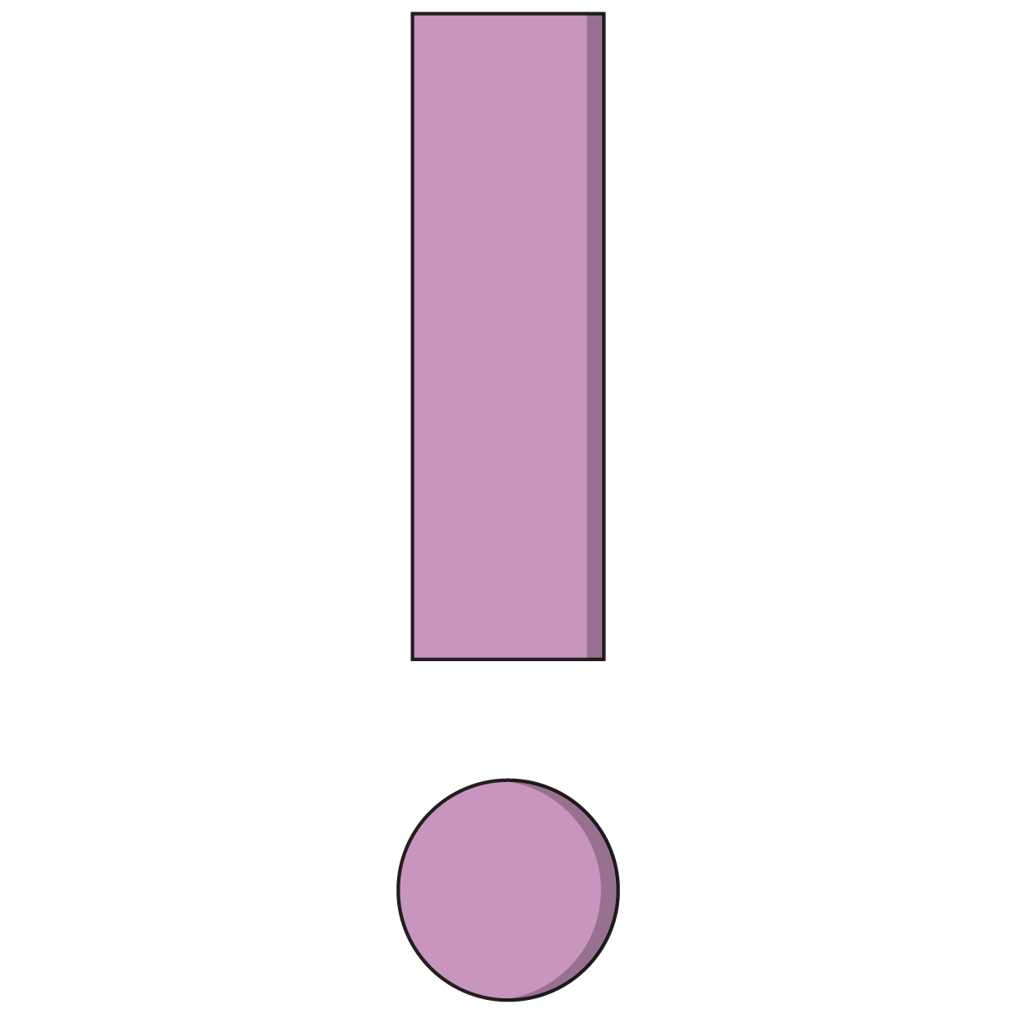
1.5 Code Fast and Break Things
15 minutes
Dealing with errors is part of everyday life in Python. Let’s explore some common mistakes in Section 1.5 of the Jupyter Notebook.
Notes:
Purpose: Have students practice identifying and fixing errors in code.

Slide 36
1.6 How Many Ways to Print With Variables?
15 minutes
Researching how to do something new is an irreplaceable skill in programming. Even if you don’t totally understand what’s going on, you still need to be able to find code snippets in documentation and use them to solve problems!
Section 1.6 of the Jupyter Notebook challenges us to find four distinct methods of achieving the same objective — save us, Stack Overflow!
Notes:
Purpose: Have students practice researching answers to coding problems.
TEACHING TIPS:
If students aren’t able to finish this exercise in class, encourage them to complete it as homework.

Slide 37
Wrapping Up
Introduction to Python
Notes:
Duration: 10 minutes

Slide 38
Recap
Looking Ahead
In today’s class, we…
Explained the value of Python.
Used Jupyter Notebook to execute basic Python programs.
Used operators to define and manipulate variables.
Differentiated between data types in Python.
On your own:
Ensure that you’ve completed the Python pre-work and pre-work quiz.
Next Class:
Data Structures
Notes:
Purpose: Recap what was covered in the lesson.

Slide 39

Don’t Forget: Exit Tickets!

